Slide 1
Hardcore Go
Ardan Labs

Slide 2


Slide 3
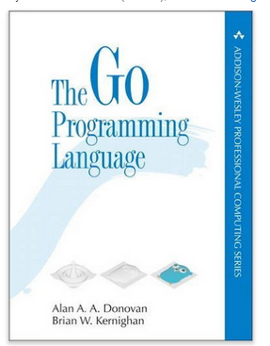

Slide 4
composition
http://www.goinggo.net/2015/09/composition-with-go.html

Slide 5
the training
https://github.com/ArdanStudios/gotraining

Slide 6
Take-Aways
mechanical sympathy
your language must work well with your hardware
readable code is your #1 priority
don’t write clever code
write code as simple as possible
type
understanding type is the foundation of go programming

Slide 7
Type
type provides two pieces of info:
size
the size, or amount of memory, we’re looking to read/write
representation
the representation of that memory: int, string, float, etc

Slide 8
Type
float64
gives you two pieces of info:
size
representation

Slide 9
Type
int
architect specific
“word” size
word is 8 bytes on 64 bit architecture
word is 4 bytes on 32 bit architecture
use “int” unless you have hardware reasons to use “int8” or “int16”

Slide 10
Type
string
built in type
also a reference type
string is a two word data structure
either 8 or 16 bytes
first word
slice of bytes
second word
len of those bytes
all reference types have a pointer
when we copy a string we are making a copy of the two words:
word 1: the pointer to the underlying array of bytes
word 2: the length
len

Slide 11
Slice
three word data structure
pointer to underlying array
length
capacity
don’t
have slice of pointers
do
have a slice of values
have slices of core data
core data needs to be in one place
as contiguous as possible
three index slice
slice2 := slice1[2:4:4]
len
cap
array

Slide 12
stack trace
reading the stack trace

Slide 13
Variable Initialization
short variable declaration operator
:=
declare and initialize at the same time
if you are setting to zero value
use
var aa int
don’t use
aa := 0

Slide 14
Constants
constants of a:
kind
don’t need a type
constants without a type are called “kind”
// Untyped Constants.
const ui = 12345 // kind: integer
const uf = 3.141592 // kind: floating-point
allows implicit conversion
type
a constant of a type
const ti int = 12345 // type: int64
const tf float64 = 3.141592 // type: float64
can’t be implicitly converted
only explicit conversion
when we’re working with variables of a type
we have to have like types
this is static typing

Slide 15
Mechanical Sympathy
keep things in memory as contiguous as possible
linked lists are bad
not necessarily contiguous
arrays are our friends
they give us contiguous blocks of memory
however they’re fixed in size
hello slices!
slices are built on top of arrays
slices grow in size
hardware can feed caches easily with arrays
stacks
today in go stacks are contiguous

Slide 16
Sharing A Value vs Reference
sharing copies is better than sharing references
keeps it on the stack, not the heap
using pointers is not more performant than sharing data
in most cases
if sharing large amounts of data, might not be true
mostly, however, share copies and not pointers (references)
sharing copies of values, as opposed to sharing pointers, allows keeping data on the stack
keeps it out of the heap
the heap is for what is shared
keep the data as contiguous as possible at all times

Slide 17
OOP
encapsulation
fields
methods
polymorphism
polymorphism
a function that can take types implementing the interface
many different types, all of which implement the interface, can be passed to the polymorphic function
interface types
only declare behavior
there is not state; no fields
it is a type
so we can create values of a type interface
name with “er” if they have one method
interfaces do things
for example
interface notifier
runs the notify method
extend / override an existing type - inheritance

Slide 18
notes

